Slide 1
LSC Learning Management System
Gardon, Jana Marie G.
Heramia, Johanna Marisse C.
Tadeo, Jose Lorenzo G.

Slide 2
Loyola Student Center (LSC)
Founded in the early 1980
Established in 1986
Named Solomon’s Ark Computer & Tutorial Services Center

Slide 3
Loyola Student Center (LSC)
Tutorial and Review Facility
High quality and affordable tutorial
Mission: To enhance the intellectual development of students
Vision: To become a center of educational excellence

Slide 4
Current System
Schedule was given manually
Grades cannot be accessed easily
Assignments and quizzes are paper-based

Slide 5
LSC Learning Management System
Frontend:
Track student’s performance
Review performance
Notify student if there are tasks
Backend:
Manage courses, tasks and attendance
Create, delete and update courses and tasks

Slide 6
Objective
General Objectives:
To provide efficient way of learning
To provide faster tracking of student’s performance
To provide easier administration
Specific Objectives
To provide system and database
To provide faster administration of records of students
To announce updates faster
To provide easier access on student’s progress

Slide 7
Benefit
To student:
Can use anywhere
Manage performance easier
To administrator:
Give tasks right away
Manage grades and attendance

Slide 8
Purpose
View schedule online
View summary of grades
View attendance online
View students progress
Update information easily

Slide 9
System Features and Functions
For Instructor:
Create course
Record attendance
Create and assign task
Give announcements
For Students:
Access review class
View attendance and schedule
Take tasks
See announcements
Keep track of grades

Slide 10
Programming Languages
HTML
CSS
PHP
JQuery
Bootstrap

Slide 11
Specific Software
Windows, Linux and Android
Yii2 advanced framework
Access on browser
MySQL for database
Enrollment system (LSC 1)

Slide 12
Security
System will run inside the firewall
Different roles for admin, student and tutor (RBAC)
Password encryption
Time limit of one hour

Slide 13
Application System Modules
Quiz
Course
User

Slide 14
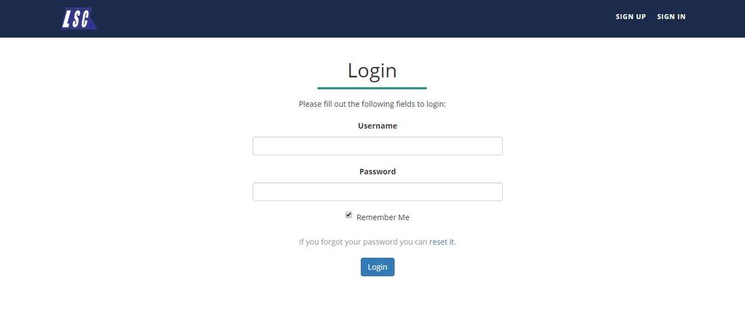
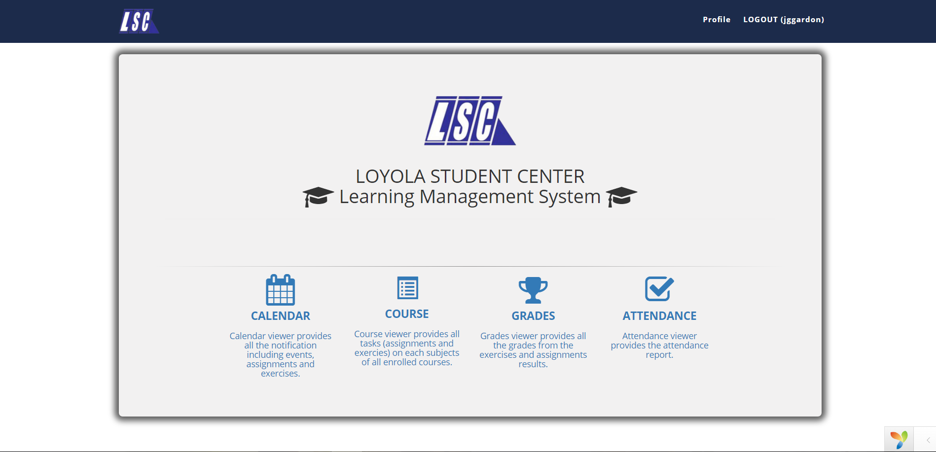
Frontend

Slide 15
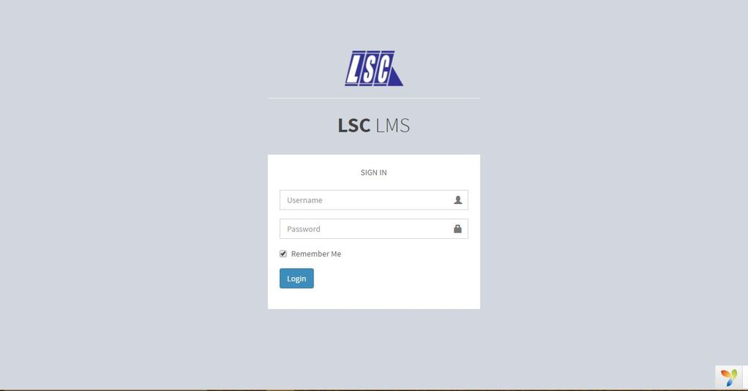
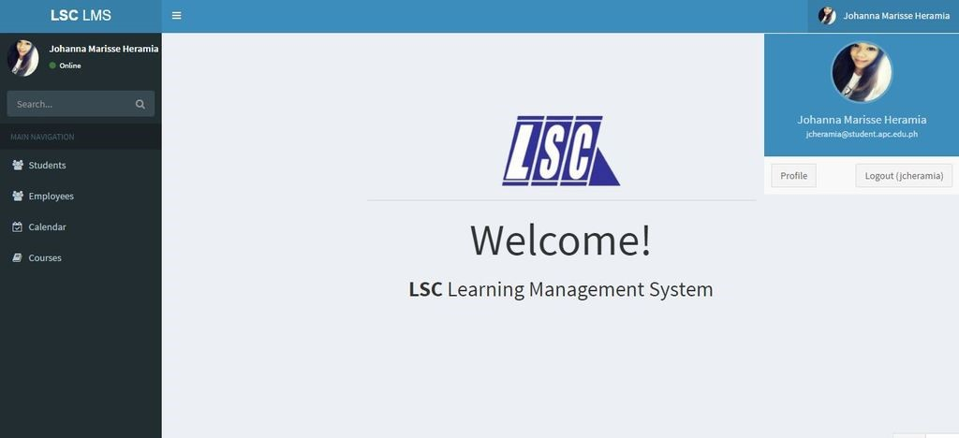
Backend

Slide 16
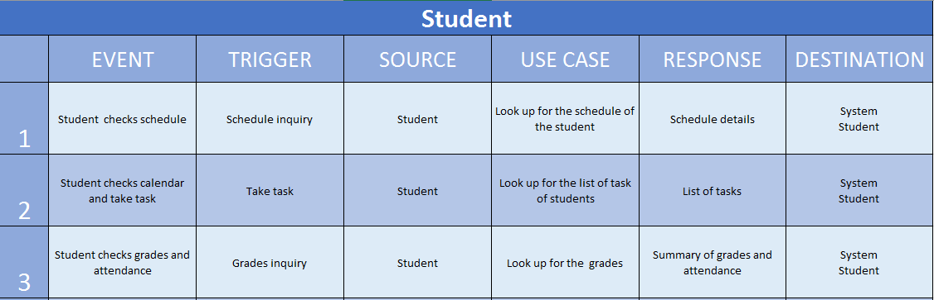
Event Table - Student

Slide 17
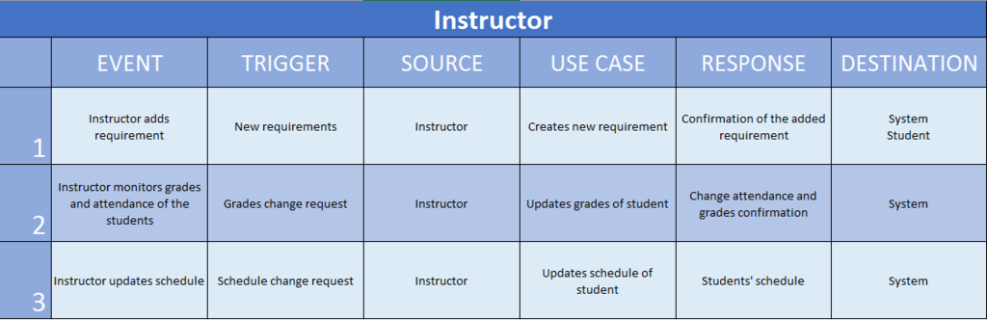
Event Table - Instructor

Slide 18
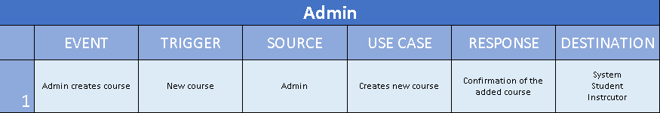
Event Table - Admin

Slide 19
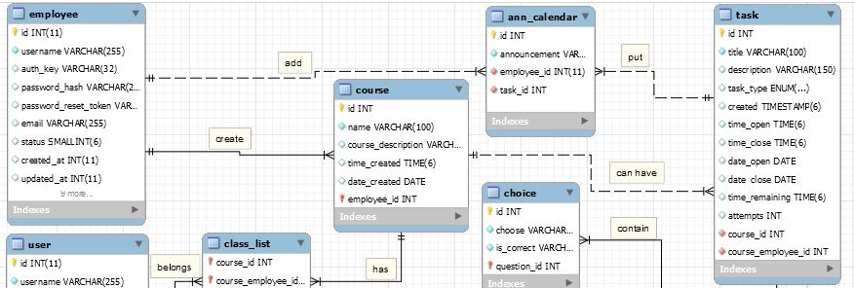
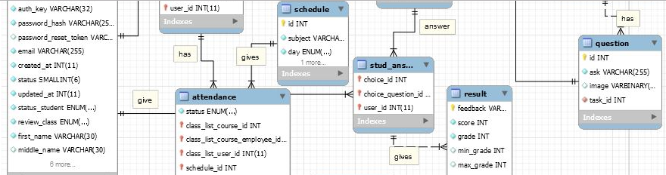
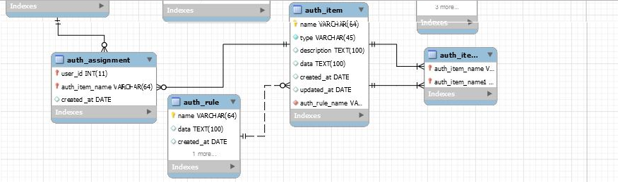
Entity Relationship Diagram

Slide 20
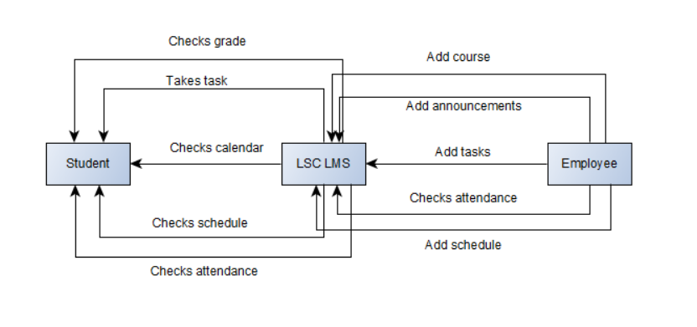
Context Flow Diagram

Slide 21
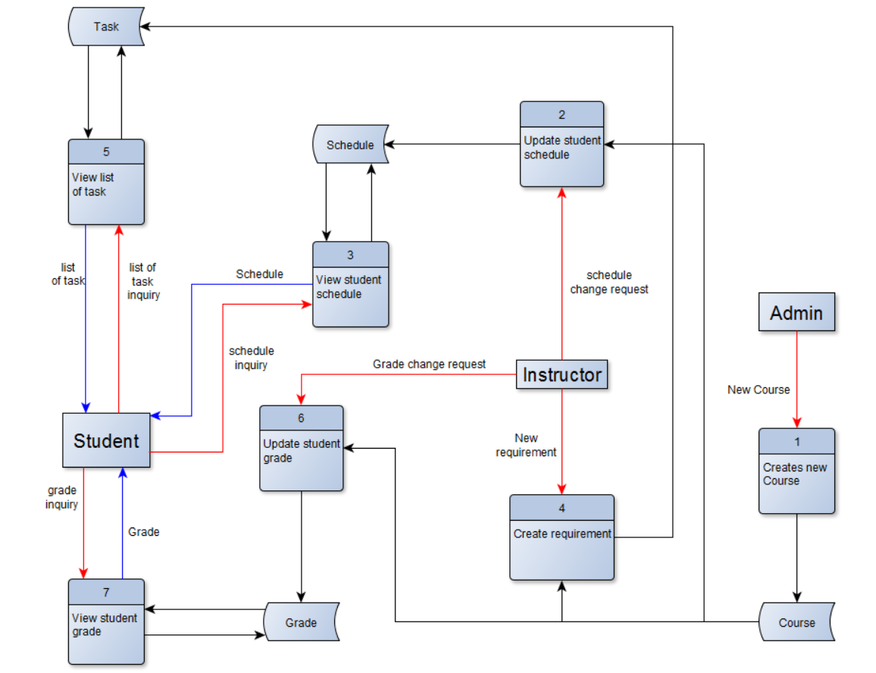
Data Flow Diagram

